Slide 1
UNDERGRADUATE RESEARCH · OURS PROJECT
Learning Mathematics
Through the Machine
Rediscovering closed-form mathematics from data with the LSSR pipeline
Rainne & Mikhail Advisor: Dr. Jimmie Adriazola, ASU
Notes:
Thanks everyone. Quick recap of where we are. The project is about getting a machine to rediscover known mathematical formulas straight from data — not by being told the formula, but by inferring it. Today I'll walk through the three stages we built: a polynomial, then e to the t, then e to the a-t. The headline: the pipeline works end to end, and we mapped out exactly why it gets hard and how to fix it.

Slide 2
THE CORE IDEA
The machine discovers the coefficients —
and the coefficients are the answer
We never tell the machine the formula. We give it data and a hypothesis space — every candidate polynomial term — and it solves for how much of each term it needs.
Curve-fitting vs. discovery
A curve fit draws a line through points.
This reads off the structure
— which terms exist and their exact values — and that structure is known mathematical truth.
D c = b
D candidate terms (Vandermonde matrix)
c coefficients — the discovery
b the data we must explain
Stage 2 preview: the coefficients come out 1, 1, ½, 1⁄6 … = the Taylor series of eᵗ, rediscovered from nothing but data.
Learning Mathematics Through the Machine · LSSR pipeline
2
Notes:
This is the whole idea in one slide. We never hand the machine the formula. We give it data and a hypothesis space — a Vandermonde matrix whose columns are every candidate polynomial term — and it solves D times c equals b for the coefficients c. The key point: those coefficients ARE the discovery. A normal curve fit just draws a line through points. What we do reads off the structure — which terms exist and their exact values — and that structure turns out to be known mathematical truth. The teaser: in Stage two the coefficients come out as one, one, a half, a sixth, which is literally the Taylor series of e to the t.

Slide 3
METHOD & ROADMAP
The LSSR pipeline, across three stages
1
2
3
4
→
→
→
Generate data
Least squares
Sparsify
Refine
ODE via Euler, or exact evaluation.
Solve D c = b for all coefficients.
Threshold: kill any |cⱼ| < ε.
Re-solve on survivors only.
We deliberately use naive thresholding — not LASSO or ISTA — as the proposal prescribes.
1
Stage 1 Polynomial
2
Stage 2 eᵗ
3
Stage 3 eᵃᵗ
t + t² — finite, sanity-checks the pipeline
Taylor series 1/n! — introduces truncation
diagonal grid — sparsity + collinearity
Learning Mathematics Through the Machine · LSSR pipeline
3
Notes:
This is the pipeline plus the roadmap on one slide. LSSR stands for Least Squares, Sparsify, Refine. Step one, generate trustworthy data. Step two, least squares for all candidate coefficients. Step three, sparsify — threshold away anything below epsilon. Step four, refine on the survivors. One thing to flag: we deliberately do NOT use LASSO or ISTA; the proposal's method is this naive thresholding. Along the bottom is our three-stage plan, each adding one new difficulty: Stage one a finite polynomial, Stage two e-to-the-t which brings truncation error, Stage three e-to-the-a-t which brings sparsity and collinearity.

Slide 4
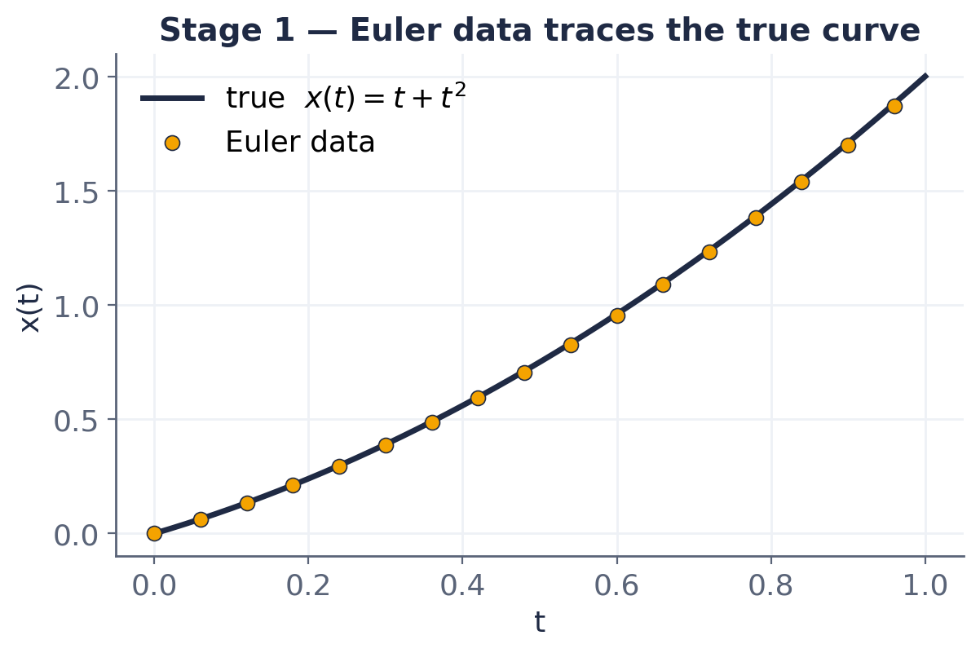
STAGE 1 — POLYNOMIAL
For testing purposes: rediscovering x(t) = t + t²
Euler's method steps along the ODE dx/dt = 1 + 2t to build trustworthy data.
Recovered coefficients
c₁ = 0.99 c₂ = 1.00
all others ≈ 10⁻¹⁵ (machine zero)
Plain least squares nails it — no sparsify needed yet.
Learning Mathematics Through the Machine · LSSR pipeline
4
Notes:
Stage one, the sanity check. We picked an ODE whose solution we already know — t plus t-squared — so we can verify the machine gets it right. Euler's method builds the data, the amber dots, which hug the true curve. Least squares recovers c-one equals zero-point-nine-nine and c-two equals one, with everything else at machine zero, ten-to-the-minus-fifteen. So the machine correctly found t plus t-squared and nothing else. Note we didn't even need the sparsify step here, because this problem is well-conditioned. That changes in Stage three.

Slide 5
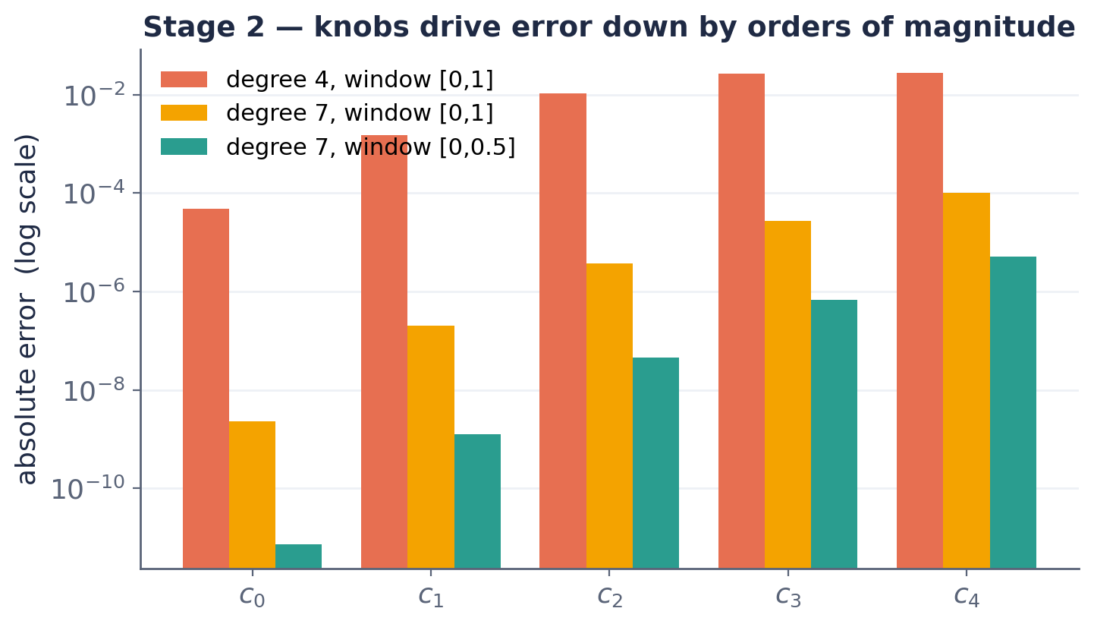
STAGE 2 — Eᵗ
Three knobs tame truncation — Taylor series recovered
11 coefficients, ~7 digits
The machine output 1, 1, ½, 1⁄6 … = 1/n!, the Taylor series of eᵗ.
1
Exact data didn't help → the error is structural, not data quality.
2
Raise degree (4→7) → pushes distortion to terms we ignore.
3
Shrink window → high powers shrink, ~10× error drop.
Learning Mathematics Through the Machine · LSSR pipeline
5
Notes:
Stage two, e to the t. Now the true answer is an infinite series but our hypothesis is finite, so the top terms get distorted — that's truncation. The chart is log scale, each gridline a factor of a hundred. Three knobs fix it. One: swapping Euler for exact data barely moved the error — a key finding, it proves the problem is structural, not data quality. Two: raising the degree from four to seven pushes the distortion to high-order terms we don't care about. Three: shrinking the window makes high powers tiny, about a ten-fold drop. With those applied, the coefficients match one-over-n-factorial to nine decimals — the machine rediscovered the Taylor series of e to the t from data.

Slide 6
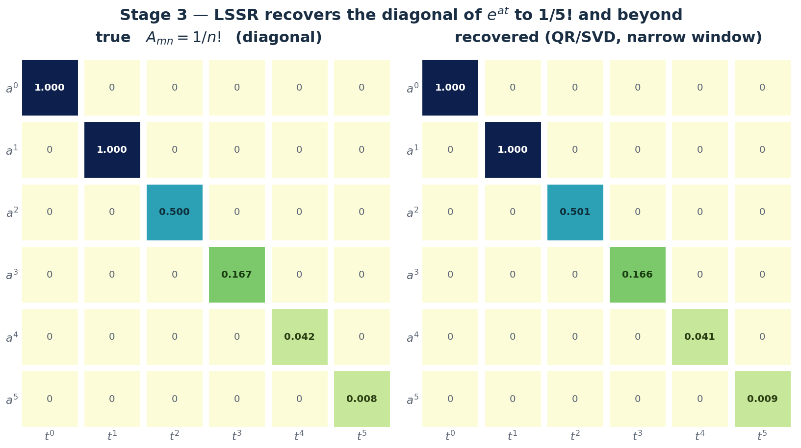
STAGE 3 — THE FIX & RESULT
Shrinking the window lets LSSR recover the exact diagonal
Window: [0, 0.5], degree 9
Window → [0, 0.5] opens a clean gap. A loose threshold keeps the full diagonal — proving the answer is eᵃᵗ.
The frontier: with degree raised and a loose threshold, the diagonal now matches to ~10⁻³ through 1/5! — the old frontier is gone.
Learning Mathematics Through the Machine · LSSR pipeline
6
Notes:
Here's the fix and the result together. We shrink the time window to zero-to-zero-point-five, which improves conditioning enough that the coefficients separate — now the smallest real term sits above the biggest junk term, so a threshold of zero-point-three-eight cleanly works. On the left is the true diagonal, on the right what LSSR recovered. The sparsify step picked exactly the right support — columns zero, five, ten, fifteen — which is precisely the diagonal, proving the structure of e to the a-t. Being honest about the frontier: the two smallest one-over-n-factorial terms are still a bit off, zero-point-four-five versus zero-point-five and zero-point-two-six versus zero-point-one-seven, because they sit near the threshold floor. The structure is right; those two values are our open problem.

Slide 7
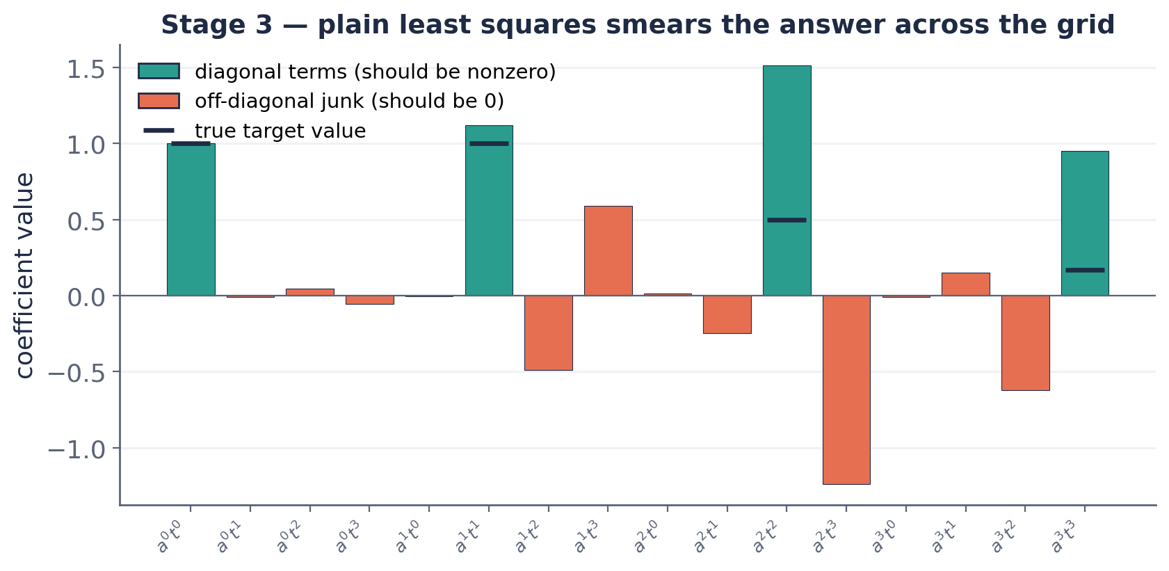
STAGE 3 — Eᵃᵗ, THE PROBLEM
Two variables → a 16-term grid, and least squares fails
eᵃᵗ pairs a power of a with a power of t → a 4×4 grid of 16 monomials. The true answer is DIAGONAL (1/n!) and m=n; the other 12 cells must be zero.
Collinearity
Junk reaches −1.24, bigger than a real term (0.95). No threshold can separate them — and exact data doesn't help.
Learning Mathematics Through the Machine · LSSR pipeline
7
Notes:
Stage three, e to the a-t. The big change is two variables, a and t. Every term pairs a power of a with a power of t, so the hypothesis becomes a four-by-four grid — sixteen candidates. The structure we're hunting: the true answer is diagonal, nonzero only when the powers match, with value one-over-n-factorial; the other twelve cells must be zero. But plain least squares falls apart — the chart shows it. The teal bars are the diagonal terms we want, the dashes are their true targets, and the coral bars are junk that should be zero but is huge. The worst junk hits minus one-point-two-four, bigger than a real term at zero-point-nine-five, so no single threshold can separate signal from junk. And it's exact data — so it's the matrix, collinearity, not the data.

Slide 8
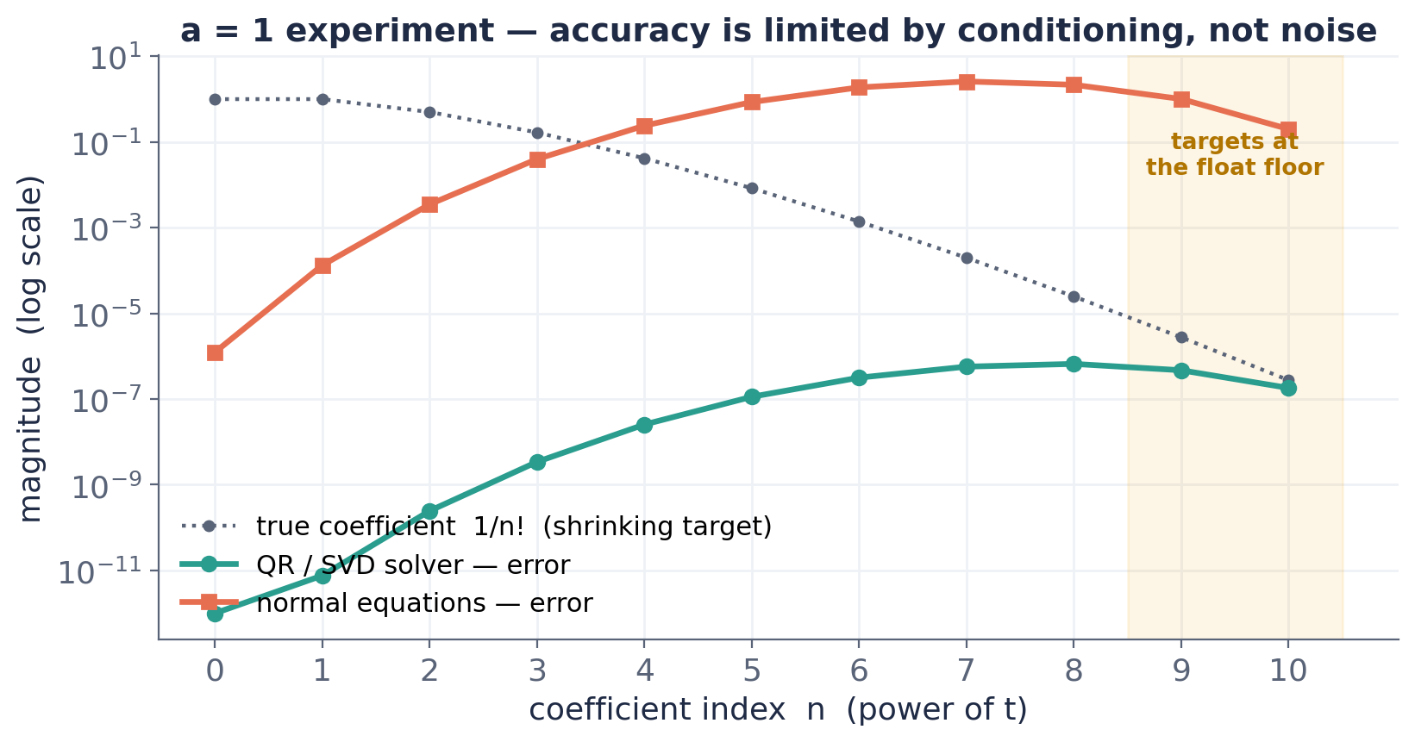
A = 1 EXPERIMENT — LEARN_EXP_AFIXED.PY
Accuracy is limited by conditioning — not noise
Fixing a = 1 → eᵗ
Drops the a-axis to one variable. We push degree to 11 — but eᵗ is infinite, the basis is finite.
QR/SVD vs normal eqns: 1.2×10⁻⁷ vs 40 error — same data. Normal eqns square the condition number.
The data is exact — no measurement noise. High-order terms hit the float floor (1/10! ≈ 3×10⁻⁷). It's numerical, not statistical.
Learning Mathematics Through the Machine · LSSR pipeline
10
Notes:
This is our a-equals-one experiment, in learn_exp_afixed.py. Fixing a to one turns e-to-the-a-t back into plain e-to-the-t, collapsing to a single variable, and he pushes the degree to ten. The key point: e-to-the-t is infinite but the Vandermonde is finite, so high-order terms are approximations. Now the result, and it's an important correction to how we first described it. The QR/SVD solver, the teal line, recovers one-over-n-factorial beautifully. The normal-equations solver, coral, blows up past n equals four — total error four-point-one versus one-times-ten-to-the-minus-six. Same data; the difference is that normal equations form D-transpose-D, squaring the condition number. We initially said the accuracy dwindles due to noise — but the data is exact, there's no measurement noise. The high-order terms degrade because the true coefficients shrink to the floating-point floor, one-over-ten-factorial is about three-times-ten-to-the-minus-seven, plus conditioning. It's a numerical limit, not noise — and notice more data made normal equations worse, reinforcing the gremlin slide.

Slide 9
METHODOLOGY
Two independent implementations — a blind cross-check
We each built the assigned problem separately, without seeing the other's code, then compared. We used different methods, but arrived at the same conclusions.
R
Rainne
M
Mikhail
Guided notebooks, LSSR by hand
Vandermonde + np.linalg.lstsq (SVD)
Stages 1–3, threshold + refit
learn_exp_afixed.py
Normal eqns AND QR/SVD, BFGS refine
a = 1 collapse, degree-11 t-series
Both independently converged on the stable SVD solve — the strongest possible validation.
Learning Mathematics Through the Machine · LSSR pipeline
9
Notes:
A word on methodology. To validate the approach, Mikhail and I each implemented the assigned problem independently — separately, without looking at each other's code — then compared. We've been calling it a double-blind test; more precisely it's an independent, or blind, parallel replication. The value is that independent bugs don't survive agreement: if two separately-written programs land on the same answer, it's the method being validated, not one person's code. And both of us independently converged on the numerically stable SVD least-squares solve. His file, learn_exp_afixed.py, is his version of the e-to-the-a-t problem, with a fixed to one.

Slide 10
WHY IT GETS HARD
Three separate gremlins — only one is fixed by more data
Underdetermination - more unknowns than equations
Truncation
Collinearity
Fewer equations than unknowns → no unique solution.
Infinite series in a finite basis distorts top terms.
Columns too alike → weight smears chaotically.
Fix: enough samples — but it saturates fast (~30–100).
Fix: raise degree, shrink window.
Fix: sparsify — NOT more data.
Learning Mathematics Through the Machine · LSSR pipeline
8
Notes:
Before Stage three, this is the conceptual core — the thing I most want you to take away. There are three separate failure modes that people often conflate. One, underdetermination: too few equations for the unknowns — fixed just by having enough data, fifteen hundred points for sixteen unknowns. Two, truncation: an infinite series in a finite basis — fixed by the degree and window knobs. Three, collinearity: the columns are too similar, so least squares can't tell them apart and smears the weight. The crucial point: collinearity is NOT fixed by more data — that's what sparsification is for. Only the first gremlin cares about data quantity.

Slide 11
WHAT WE LEARNED
Eleven conclusions at a glance
What the method does
The two knobs
Hidden failure modes
1 · Finite basis recovers an infinite series only up to truncation.
4 · Not obvious in the circle problem — its truth had no tail.
9 · More data saturates by ~30–100 samples.
2 · The highest kept coefficient is least accurate.
3 · Degree and window are coupled — move them together.
5 · Narrow window starves high-order terms.
6 · Wide window + low degree → tail explodes.
7 · Narrow window + high degree → best recovery.
8 · Conditioning is separate from truncation; QR/SVD ~9 orders better than normal eqns.
10 · Fixed 10% threshold kills small true coefficients; loosening it disables sparsify.
11 · Vector (a=1) beats matrix: fewer unknowns, no leakage, ~10⁸× better conditioned.
Rainne & Mikhail · the five slides that follow unpack each theme

Slide 12
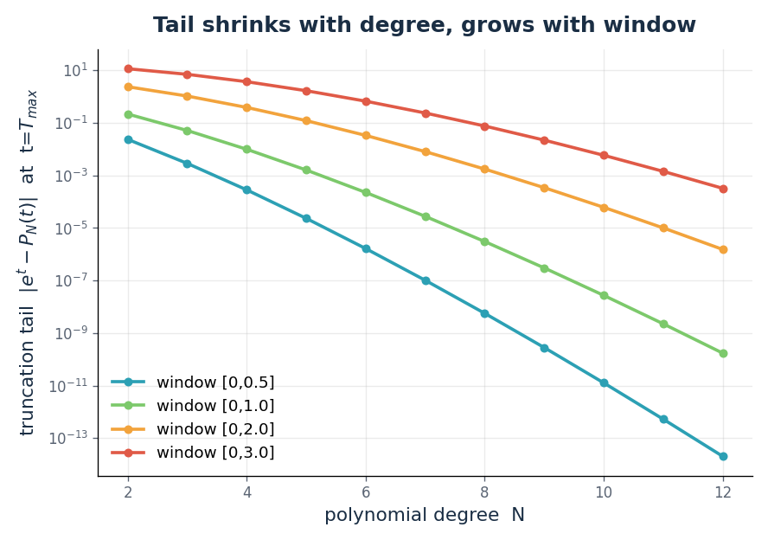
CONCLUSIONS · 1 of 5
Truncation: a finite basis can't hold an infinite series
The target is a Maclaurin series:
eᵗ = Σ tⁿ/n! (n = 0 … ∞)
A degree-N fit keeps only the first N+1 terms. The discarded tail is
eᵗ − P_N(t) = Σ tⁿ/n! (n = N+1 … ∞)
① LSSR recovers finite polynomials exactly, but an infinite series only up to this tail.
② The highest kept coefficient is least accurate — it absorbs the unrepresented tail.
④ This wasn't obvious in the circle problem: its truth was an exact degree-2 polynomial, so the tail was zero.
Rainne & Mikhail · Learning Mathematics Through the Machine

Slide 13
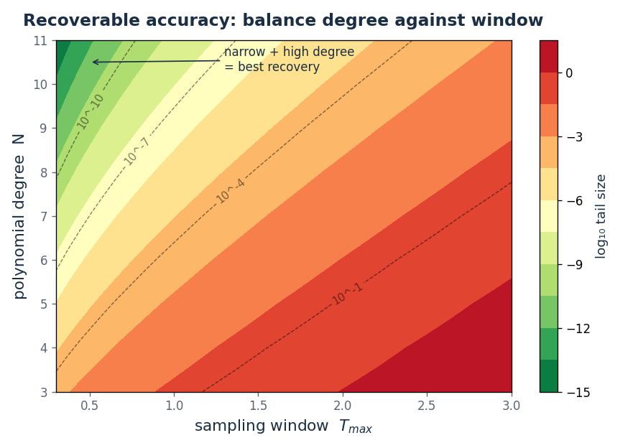
CONCLUSIONS · 2 of 5
Two knobs: degree and window must move together
The first dropped term sets the error floor:
|tail| ≈ T_max^(N+1) / (N+1)!
③ Keep this term below your target accuracy — degree N and window T_max are coupled.
⑤ Narrow window → high-order terms starve: tⁿ is tiny for t < 1, so there's little signal.
⑥ Wide window + low degree → the tail T_max^(N+1)/(N+1)! explodes.
⑦ Narrow window + high degree → tail → 0: best recovery.
Rainne & Mikhail · Learning Mathematics Through the Machine

Slide 14
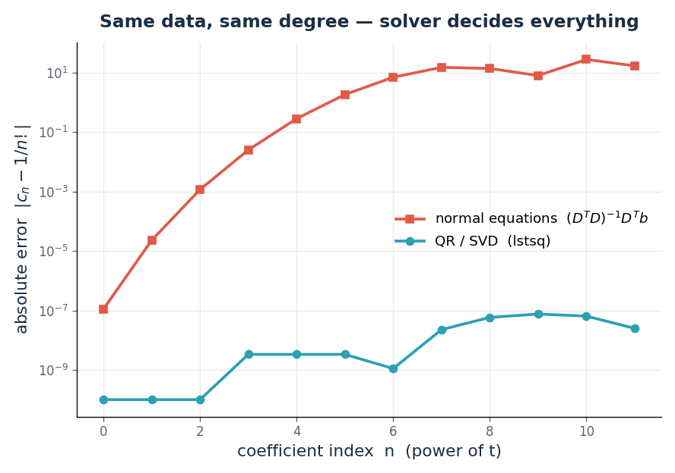
CONCLUSIONS · 3 of 5
Conditioning: a failure mode separate from truncation
Normal equations square the condition number:
cond(DᵀD) ≈ cond(D)²
QR/SVD solves Dc = b directly, never forming DᵀD, so it keeps cond(D) intact.
⑧ Truncation is a property of the math; conditioning is a property of the solve. They stack at high degree.
At degree 11, same data: normal eqns give error ≈ 40, QR/SVD ≈ 1.2×10⁻⁷ — about 9 orders apart.
Rainne & Mikhail · Learning Mathematics Through the Machine

Slide 15
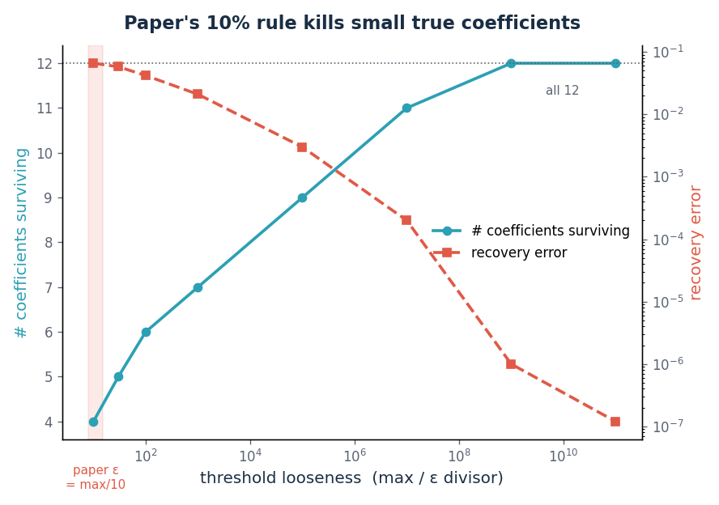
CONCLUSIONS · 4 of 5
Threshold vs. starvation: when sparsify backfires
The true coefficients span many orders:
1, 1, ½, … , 1/11! ≈ 2.5×10⁻⁸
The paper's rule zeros any |cⱼ| < ε, with ε = max/10 = 0.1.
⑩ That threshold annihilates every true coefficient past 1/3! — they look like noise to a relative cutoff.
Loosening ε to keep them recovers all 12 — but then nothing is sparsified, so LSSR collapses to LS + refine.
Rainne & Mikhail · Learning Mathematics Through the Machine

Slide 16
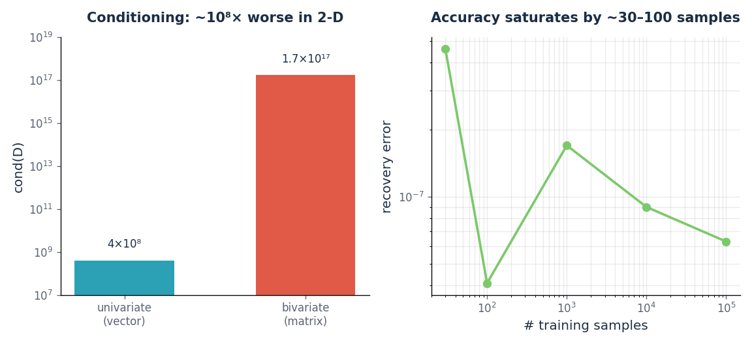
CONCLUSIONS · 5 of 5
Dimensionality: a vector beats a matrix
Fixing a = 1 reduces the unknowns:
(M+1)(N+1) matrix → (N+1) vector
⑪ The vector form wins three ways: fewer unknowns, no all-zero off-diagonal block to absorb error, and a far better-conditioned design matrix.
⑨ More data saturates: accuracy floors out by ~30–100 samples; extra samples are wasted compute.
Caveat: the matrix form solves the harder, more general problem — it discovers that a and t enter only as the product at.
Rainne & Mikhail · Learning Mathematics Through the Machine

